Slide 1
SMART VIRTUAL HACKATHON -2020 TECHONZ CRIMINAL IDENTIFICATION SYSTEM BASED ON OPEN CV
TEAM MEMBERS: PROJECT GUIDE:
VEDHA MUKUND A V Mrs.S.JANSI RANI AP(Sr.Gr) IT
VIDUL M
UTHIRAPATHI ESWARAN S
/

Slide 2
CONTENTS:
Problem statement
Existing System
Solution and Proposed System
Block Diagram
System Context Diagram
Methodology
Modules
Applications
Web Reference
/

Slide 3
PROBLEM STATEMENT :
Everyday there’s some crime happening somewhere and getting arrested,yet some criminals get escaped ,and days passed ,old criminals were not noticed.It gets difficult to identify those criminals.
/

Slide 4
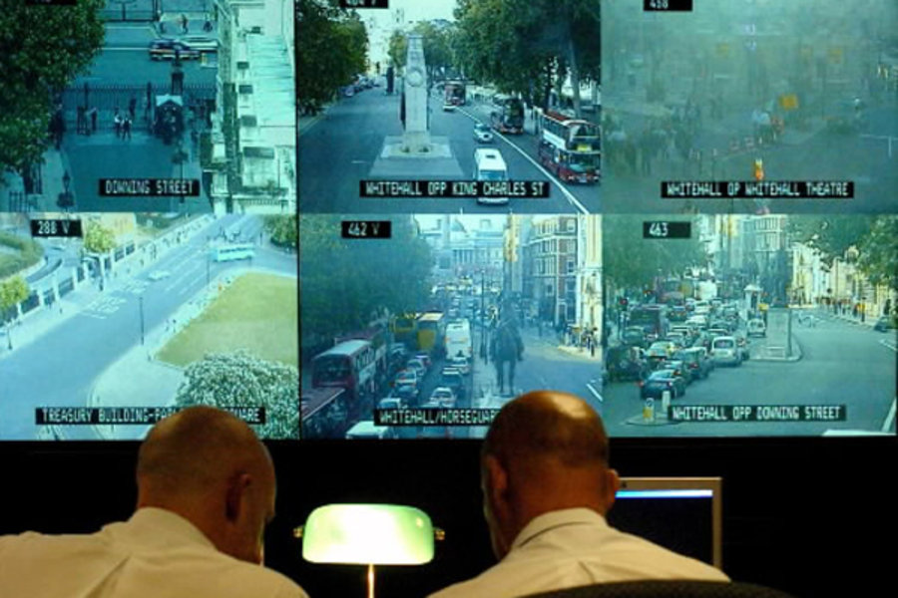
EXISTING SYSTEM:
Manual searching through CCTV cameras.
/

Slide 5
SOLUTION:
The captured image from the web camera will get detected first and then cropped to reach the computer.
This detection is performed through Viola-Jones Haar cascade classifier.Using a python based Open CV software.
Whenever an image arrives,the server commences LBPH algorithm on this face, process the image to minimize the variations and finally compares the emanated LBPH from detected image with the pre-saved LBPH in the database.
The result of comparison is generated by sending a notification as authorized or unauthorized person via internet of things.
/

Slide 6
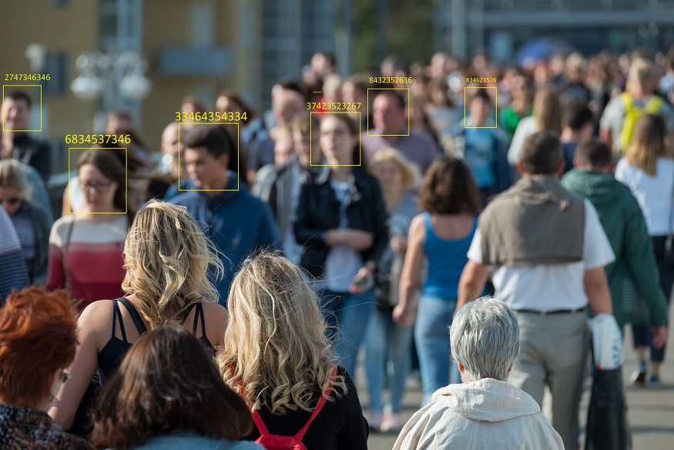
PROPOSED SYSTEM: When the criminal identified , colour of the frame is different and alert message is sent to nearest station.
/

Slide 7
BLOCK DIAGRAM:
Image
Acquisition
Image
processing
Extraction of
Facial features
Decision
comparing with
database
/

Slide 8
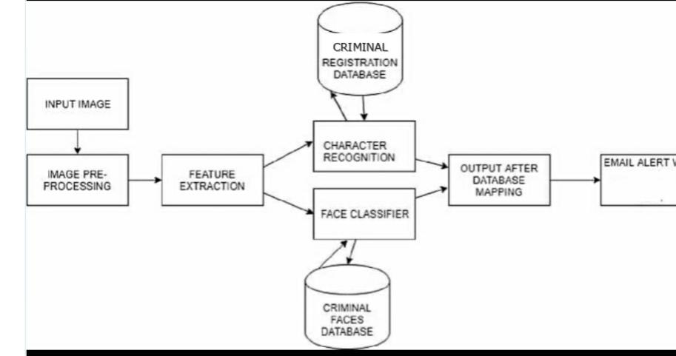
SYSTEM CONTEXT DIAGRAM:

Slide 9
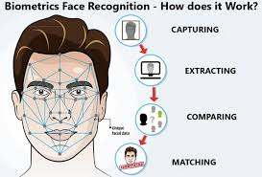
METHODOLOGY: After capturing images , the facial features are extracted and compared to all samples in database .
/

Slide 10
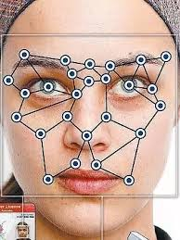
EXTRACTION OF FACIAL FEATURES:
Every face has atleast 80 distinguishable parts called nodal points.
Like distance between eyes
Width of nose.
Depth of eye socket.
Structure of cheekbones.
Length of jaw line.
/

Slide 11
FACE RECOGNITION :
The implementation of face recognition technology includes the following three stages:
Image acquisition .
Image processing.
Face image classification and decision making.
/

Slide 12
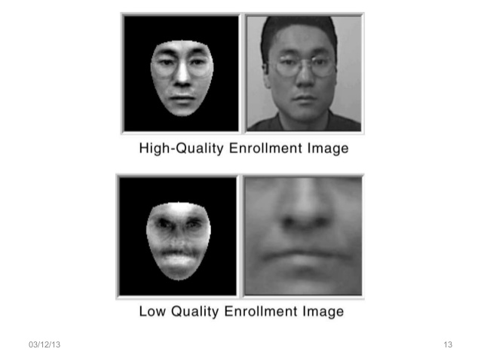
IMAGE ACQUISITION: High -quality is essential to eventual verification and identification enrolment images define the facial characteristics to be used in all future authentication events.
IMAGE PROCESSING:
Images are cropped made black and white in order to facilitate initial comparison on gray scale. Once the face is detected , localised and normalized process may be required to bring the dimension of the live facial sample in alignment with the one on the template.
/

Slide 13
OTHER APPLICATIONS:
Primary application being used in classroom to take attendance of the students.
Decreases the false attendance .
Security /Counterterrorism: Access control , comparing surveillance images to know terrorist.
ATM: the software is able to quickly verify a customer ‘s face.
Healthcare: Minimize fraud by verifying identity.
/

Slide 14
REFERENCES :
Brain C.Becker ,Enrique G.Ortiz, “Evaluation of Face Recognition
Techniques ”,IEEE ,2008.
http://ieeexplore.ieee.org/document/7916753/
https://link.springer.com/chapter/10.1007/978-3-030-01054-6_17
Video reference:https://www.youtube.com/watch?v=HO9Zdm35VlQ
/

Slide 15
MODULES :
MODULE1: FACE DETECTION
MODULE2: DATASET GENERATION
MODULE3: PROCESSING THE DATASET
MODULE4: CRIMINAL IDENTIFICATION AND ALART MESSAGE.
/

Slide 16
MODULE 1: FACE DETECTION
Using Cascading technique,trained with lot of positive and negative images,used to detect only the face avoiding noice.
HaarCascades classifier algorithm trained in some given input faces and non-faces and training a classifier that identifies face.
The cascades are passed as arguments
/

Slide 17
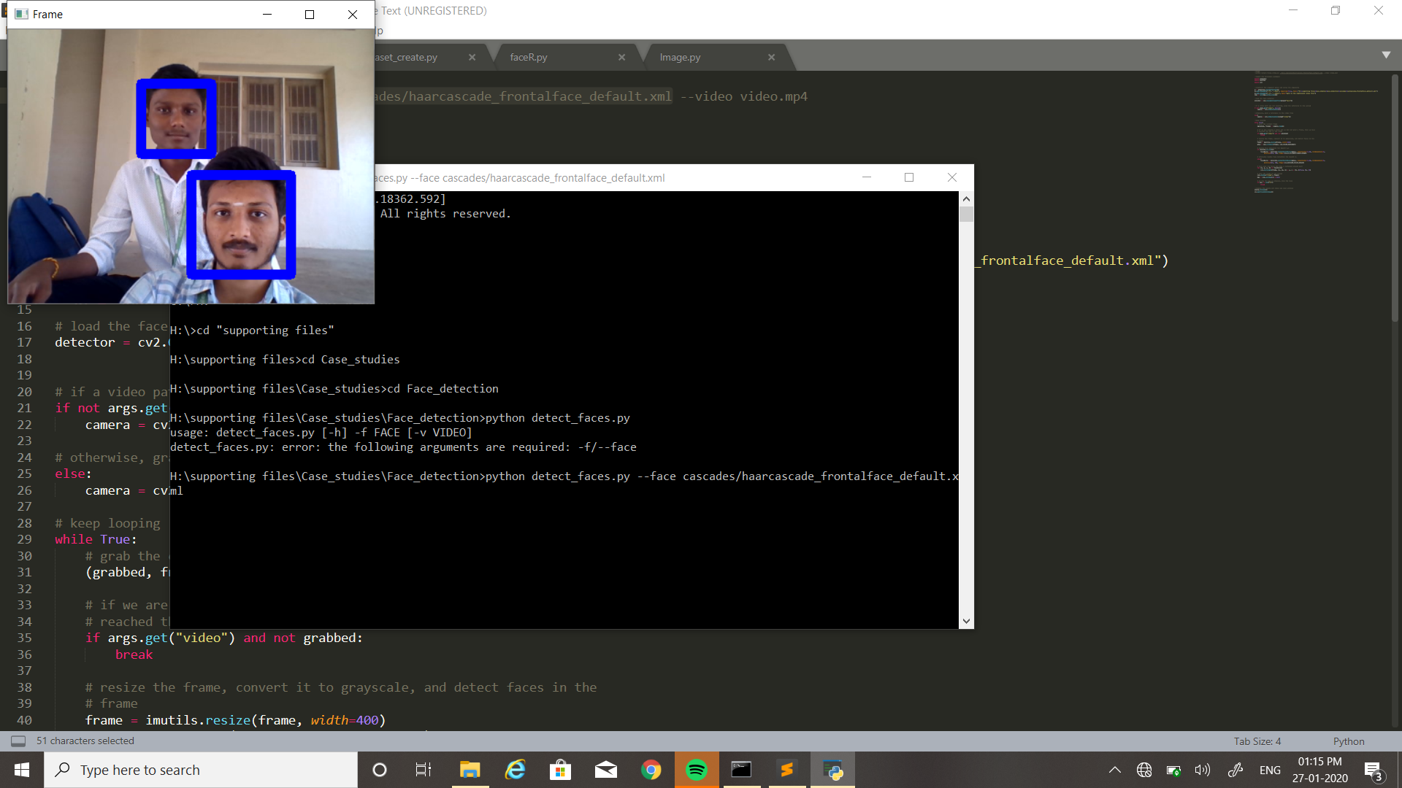
MODULE 1: OUTPUT
/

Slide 18
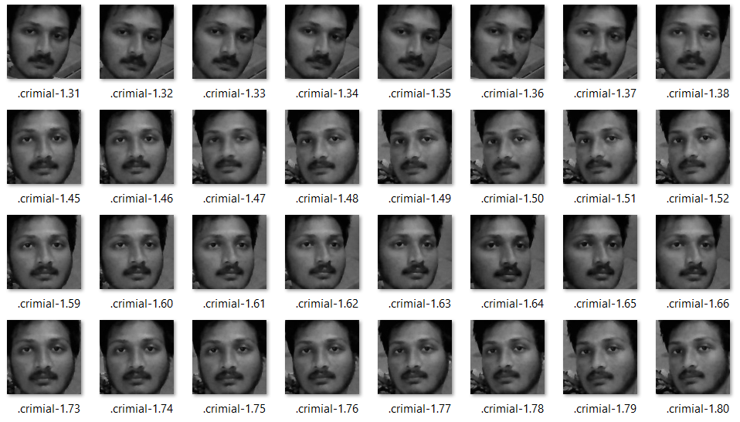
MODULE 2: DATASET GENERATION A range of 1000 images is trained for a criminal.
/

Slide 19
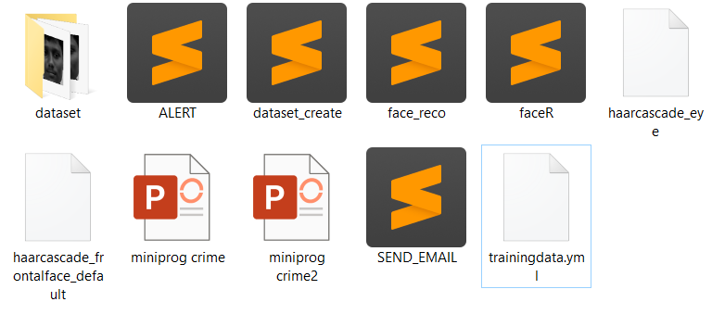
MODULE 3:PROCESSING THE DATASET
The processed dataset is stored as a file(.yml)
/

Slide 20
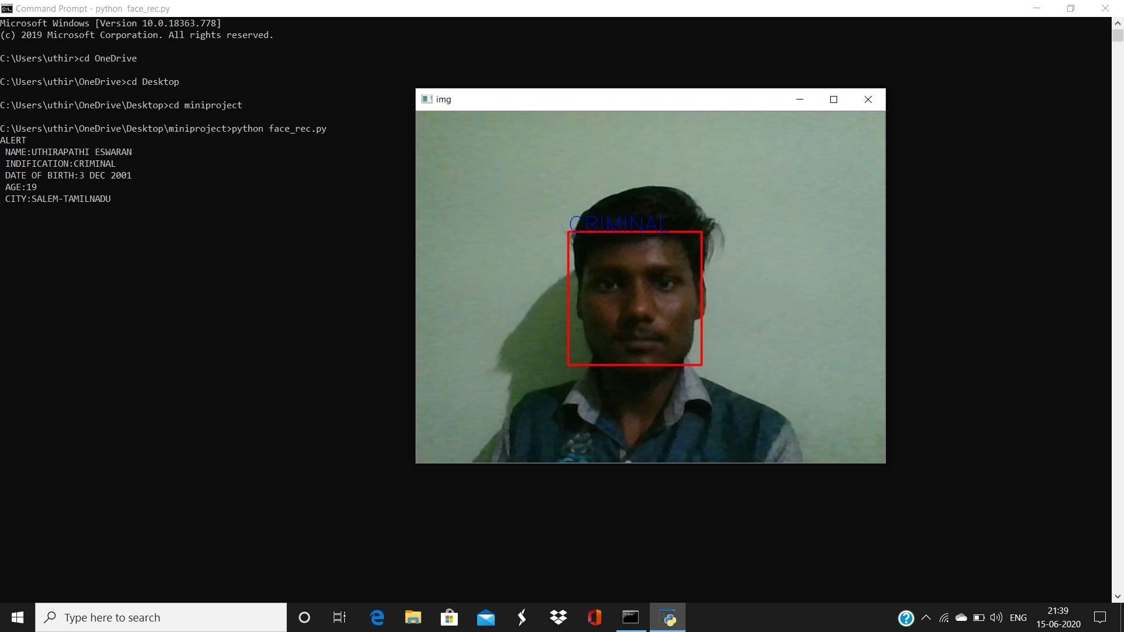
MODULE 4:CRIMINAL IDENTIFICATION
The identified person is labelled as criminal.
/

Slide 21
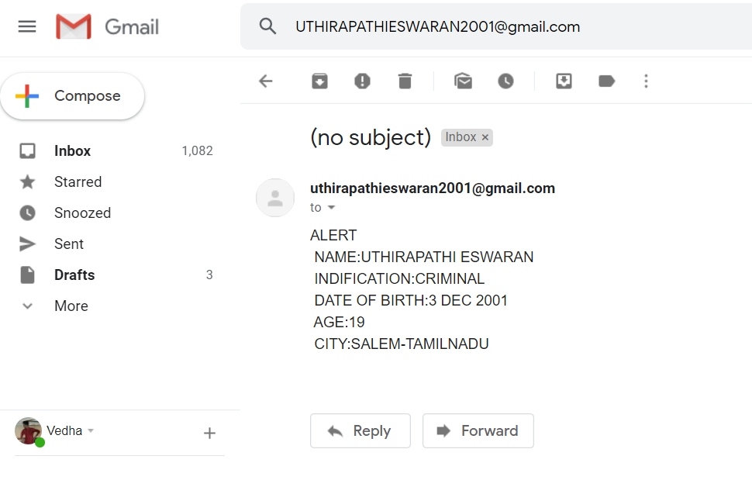
ALERT MESSAGE:
When the criminal is identified an Alert mail is sent to the specified police station , the mail is sent through the SMTP protocol.

Slide 22
___THANK YOU___
/

